Slide 1
Application Control Using 3D Gesture Recognition

Slide 2
CONTENTS
Objective
Introduction
Methodology
Tools
Implementation
Test Result
Advantages
Application
Future Scope

Slide 3
OBJECTIVE
To control applications based on gesture images using a camera, perform background removal and extract hand gesture using segmentation, extract features using PCA (Eigen values & vectors)

Slide 4
INTRODUCTION
Gesture recognition enables humans to interact with computers using natural hand movements.
Traditional input devices like keyboard and mouse are not always convenient or accessible.
This project focuses on recognizing 3D hand gestures for Human– Computer Interaction (HCI).
Recognized gestures are used to control computer applications.
The system uses image processing and pattern recognition techniques for accurate results.

Slide 5

METHODOLOGY
Acquiring 3D gesture as input through a camera or from a database
Preprocessing the image of gesture bringing it to a standard resolution
Segmentation of the image by removing background HSV and YbCr threshold algorithms
Feature extraction using covariance matrices, Eigen values and Eigen Vectors
Gesture identification by comparison of the projected test and train image matrices
Giving text output and executing respective application as per gesture

Slide 6
TOOLS
Software Tools:
MATLAB
Hardware Tools:
Webcam or Laptop Camera
Computer System (Windows/Linux)

Slide 7
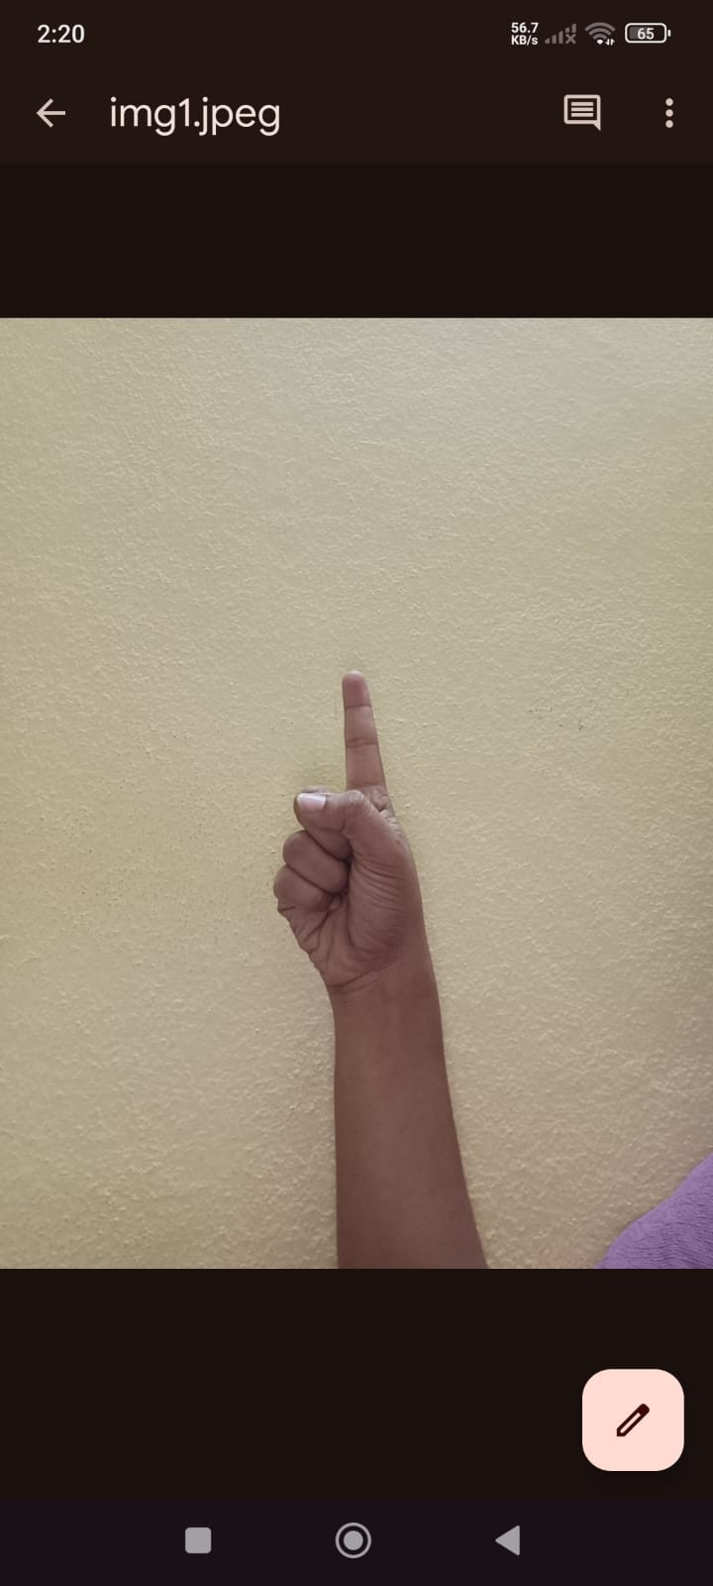
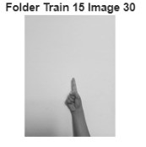
I
IMPLEMENTATION
PREPROCESSING
Load all folders from the training directory (Train).Extract numerical labels from folder names. Read each image from every folder. Resize images to a fixed dimension. Converted images to grayscale.
Input image
preprocessed image

Slide 8
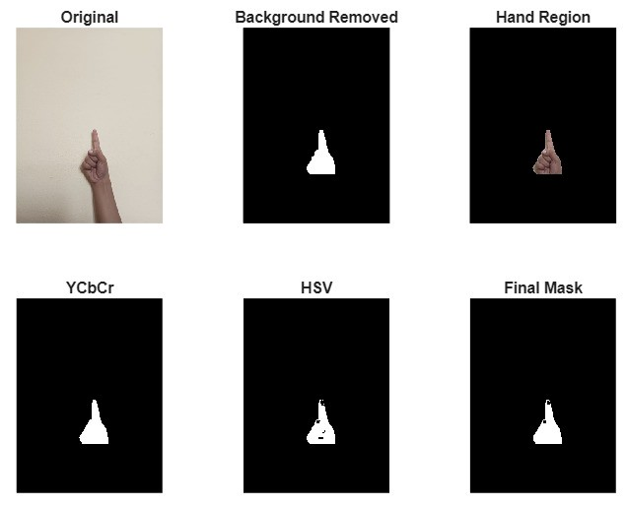
SEGMENTATION
Converted image to binary, remove noise, refine using morphological operations. Extract largest component as hand region. Apply shadow removal and mask cleaning. Used YCbCr & HSV for accurate skin detection. Obtained final segmented hand image

Slide 9
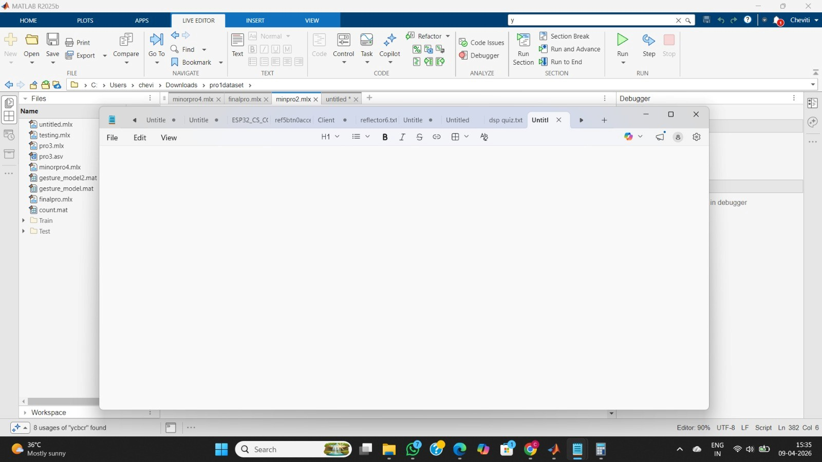
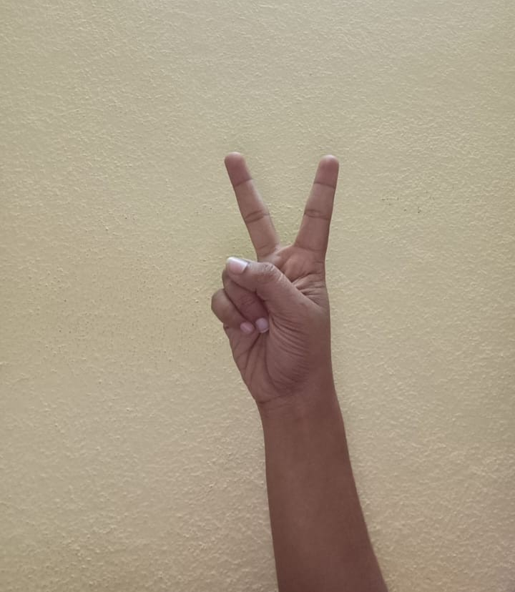
TEST RESULT

Slide 10
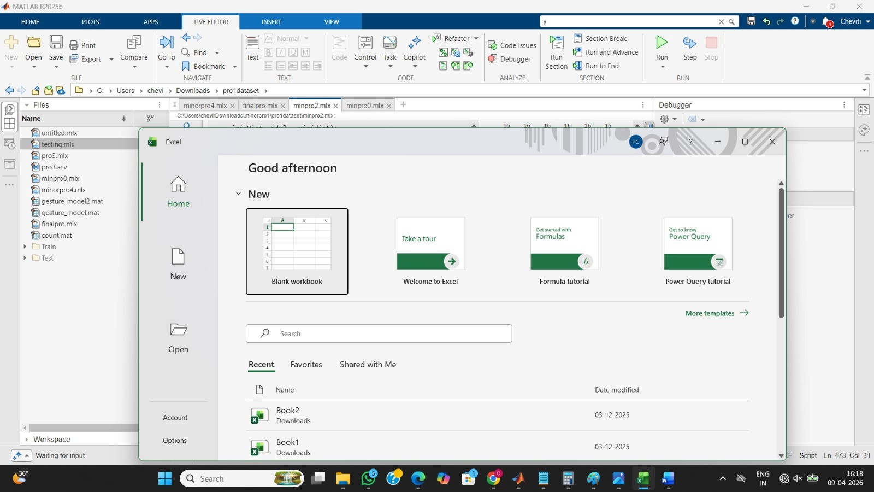

Slide 11
ADVANTAGES
Enables touch-free interaction, improving hygiene
Provides natural and intuitive control using hand gestures
Useful for physically challenged users
Reduces dependency on keyboard and mouse
Enhances user experience and accessibility
Works in real-time with quick response
Can be integrated with multiple applications

Slide 12
APPLICATIONS
Touchless PC Control System
Touchless Medical Interface
Smart Home Control System
Gesture-Based Media Player Control
Gesture-Controlled Presentation System
Assistive Technology for Disabled Users
In-Car Gesture Control System
Gesture-Based Gaming System

Slide 13
FUTURE SCOPE
Extend system to recognize dynamic (motion-based) gestures
Expand to sign language recognition for communication
Implement in AR/VR environments for immersive control

Slide 14
REFERENCES
[1] Reza Hassanpour, Asadollah Shahbahrami, ―Human Computer Interaction Using Vision-Based Hand Gesture Recognition‖, Journal of Advances in Computer Research, 2010.
[2] Dharani Mazumdar, Anjan Kumar Talukdar & Kandarpa Kumar Sarma , ―A coloured fingertip-based tracking method for continuous hand gesture recognition‖, International Journal of Electronics Signals and Systems (IJESS), ISSN: 2231- 5969, Vol 3, Iss-1, 2013.
[3] Hazem Khaled, S. Sayed, El Sayed Mostafa ,Hossam Ali , ―Hand Gesture Recognition Using Average Background and Logical Heuristic Equations‖, International Journal Of Computers & Technology, ISSN 2277-3061, Vol. 11 No. 5, 2013.
[4] Joyeeta Singha, Karen Das, ―Indian Sign Language Recognition Using Eigen Value Weighted Euclidean Distance Based Classification Technique‖, International Journal of Advanced Computer Science and Applications, Vol. 4, No. 2, 2013.
[5] Ashutosh Verule, Shrivardhan Suryawanshi, Poonam Rajput and Rajashri Itkarka , ― Application Control Using 3D Gesture Recognition

Slide 15
THANK YOU

